Slide 1
Using the Key Board and Video Display
DOS & BIOS interrupts
Disk files
Example Programs.

Slide 2
Using keyboard and video display (DOS 21H functions, BIOS 10H functions)
Interrupt Type | Description
00h-1Fh | BIOS Interrupts
20h-3Fh | DOS Interrupts
40h-7Fh | reserved
80h-F0h | ROM BASIC
F1h-FFh | not used

Slide 3
DOS(Disk Operating System) 21H SEVICES
There are 87 different functions supported by this interrupt, identified by a function number placed in the AH register.

Slide 4
1.Description of commonly used character input functions
int 21h character input with echo function 01h
Reads a character from the standard input device and echoes it to the standard output device. If no character is ready, waits until one is pressed
Calling parameters
AH=01H
Returns
AL=8 bit input data
Ex:
MOV AH,01H
INT 21H;

Slide 5
int 21h character input without echo function 08h
Reads a character from the standard input device without echoing it to the standard output device. If no character is ready, waits until one is available
Calling parameters
AH=08H
Returns
AL=8 bit input data
Ex:
MOV AH,08H
INT 21H;

Slide 6
int 21h buffered keyboard input function 0Ah(10)
Reads a string of bytes from the standard input device, up to and including an ASCII carriage return(0Dh) and places them in user designated buffer. The characters are echoed to the standard output device
Calling parameters
AH=0AH
DS:DX=segment :offset of buffer
Returns
nothing(data placed in buffer)

Slide 7
Note:
The buffer used by this function has the following format:
Byte Contents
0 Maximum number of characters to read, set by program
1 Number of characters actually read
2 String read from keyboard terminated by carriage return (0Dh)

Slide 8
Example:
Data segment
buf1 db 257 dup(?)
Data ends
Code segment
:
MOV buf1,255
LEA DX,buf1
MOV AH,0AH
INT 21H
:
Code ends

Slide 9
2.Writing to video display : (display functions)
1.Output character
int 21h character output function 02h
Outputs the character to the standard output device
Calling parameters
AH=02H
DL=8 bit data for output
Returns
nothing
Ex:
MOV DL,’*’
MOV AH,02H
INT 21H;

Slide 10
2.Display string
int 21h display string function 09h
Sends a string characters to the standard output device. End of string is indicated by character $
Calling parameters
AH=09H
DS:DX= segment: offset of string
Returns
nothing

Slide 11
Ex:
data segment
msg db “microprocessor $”
data ends
Code segment
Assume cs:code,ds:data
start:
mov ax,data
mov ds,ax
mov dx,offset msg
mov ah,09h
int 21h
mov ah,4ch
int 21h
Code ends
End start

Slide 12
Create sub-directory:
int 21h create sub-directory function 39h
Creates sub-directory using specified drive and path.
ASCIIZ is a string file that ends with 00h or null character (ASCII string with a zero on the end instead of a dollar sign)
Calling parameters
AH=39h
DS:DX -> seg: offset of ASCIIZ path specification
Return:
If successful, CF clear
If not successful,CF set ,AX = error code

Slide 13
EX:
data segment
path1 db ‘abc’,0
path2 db ‘c:\xyz\abd’,0
path3 db ‘c:\mn’,0
Data ends
Code segment
MOV AH,39H
MOV DX,OFFSET path1 or LEA DX, path1
INT 21H
jc ERROR
Code ends

Slide 14
Delete sub-directory:
int 21h delete sub-directory function 3Ah
Removes sub-directory using specified disk and path
Calling parameters
AH=3Ah
DS:DX -> seg: offset of ASCIIZ path specification(ASCIIZ pathname of directory to be removed)
Return:
If successful, CF clear
If not successful, CF set ,AX = error code

Slide 15
EX:
data segment
path db ‘c:\mn’,0
Data ends
Code segment
MOV AH,3AH
MOV DX,OFFSET path
INT 21H
Code ends

Slide 16
Set/change current directory:
int 21h set /change current directory function 3Bh
Sets the current or default directory using specified drive and path
Calling parameters
AH=3Bh
DS:DX -> seg: offset of ASCIIZ path specification (ASCIIZ pathname to become current directory)
Return:
If successful, CF clear
If not successful,CF set ,AX = error code

Slide 17
EX:
data segment
path db ‘c:\mn’,0
Data ends
Code segment
MOV AH,3BH
MOV DX,OFFSET path
INT 21H
Code ends

Slide 18
3.File Handling
1.File creation
int 21h create or truncate file function 3Ch
Creates a new file in the designated or default directory on the designated of default disk drive. If specified file already exists it is truncated to zero length.
Calling parameters
AH=3Ch
CX= File attributes
DS:DX = seg: offset of ASCIIZ filename

Slide 19
Byte | Description
00h | Normal file attribute
01h | Read only
02h | Hidden file(prevents a file from appearing in directory string)
04h | Specifies System File
08h | Volume(specifies the name of the disk volume)
10h | Sub-directory(specifies sub-directory name)
20h | Archive(indicates that a file has changed since the last backup)
File attributes:
Return:
If successful,
CF clear ,AX = file handle
If not successful,
CF set ,AX = error code (03h,04h,05h)
(03H- If path not found
04H -If no handle
05h -If access denied)

Slide 20
Example:
data segment
file1 db ‘abc.txt’,0
file2 db ‘c:\xyz\abd.txt’,0
file3 db ‘c:\mn.txt’,0
Data ends
Code segment
:
LEA DX,file1
MOV CX,20H
MOV AH,3CH
INT 21H
:
code ends

Slide 21
2.Open File:
int 21h open file function 3Dh
Given an ASCIIZ file specification opens the specified file in the designated or default directory on the designated or default disk drive
Calling parameters
AH=3Dh
AL=access mode(type of operations allowed for the opened file)
AL=00H,The file is opened to read
AL=01H,The file opened to write
AL=02H,the file is opened to read or write
DS:DX -> seg: offset of ASCIIZ file specification
Return:
If successful, CF clear ,AX = file handle
If not successful,CF set ,AX = error code

Slide 22
Example:
Data segment
filename db ‘temp.asm’,0
Data ends
Code segment
MOV AL, 02H
MOV AH,3DH
LEA DX, filename
INT 21h; AX has handle
Code ends

Slide 23
3.Close File:
int 21h close file function 3Eh
Given a file handle that was returned by previous successful open or create operation ,flushes all internal buffer to disk, closes the file, and releases the handle for reuse. If file was modified or extended the time and date, stamp and the file size are updated in directory entry
Calling parameters
AH=3Eh
BX=file handle
Return:
If successful, CF clear ,
If not successful,CF set ,AX = error code,6 if handle invalid or not open

Slide 24
Example:
Data segment
filename db ‘temp.asm’,0
Data ends
Code segment
MOV BX,AX ;Assume AX has the file handle
MOV AH,3EH
INT 21h
Code ends

Slide 25
4.Read File:
int 21h read file function 3Fh
Given a valid file handle from a previous successful open or create operation, a buffer address and a length in bytes, transfers data at the current file pointer from the file into the buffer and then updates the file pointer position.
Calling parameters
AH=3Fh
BX=File handle
CX=no of bytes to be read
DS:DX -> seg: offset of buffer area
Return:
If successful, CF clear ,AX = no of bytes read
If not successful,CF set ,AX = error code

Slide 26
Example(Open/read/closing the file)
DATA SEGMENT
filename db ‘temp.asm’,0
buf db 256 dup(?)
DATA ENDS
CODE SEGMENT
MOV AL, 02H
MOV AH,3DH ;Open file function
LEA DX,filename ;address of filename
INT 21h ;AX has handle
MOV BX,AX ;BX has handle
MOV AH,3FH ;Read file function
MOV CX,256 ;read 256 bytes
LEA DX,buf ;store data at buf
INT 21H
MOV AH,3EH ;Close file function
INT 21H
CODE ENDS

Slide 27
5.Write to File:
int 21h write to file function 40h
Given a valid file handle from a previous successful open or create operation, a buffer address and a length in bytes, transfers data from the buffer into the file and updates the file pointer positions.
File must be created or opened
By default file creation we can write
Calling parameters
AH=40h
BX=File handle
CX=no of bytes to be written
DS:DX -> seg: offset of buffer area
Return:
If successful, CF clear ,AX = no of bytes written
If not successful,CF set ,AX = error code

Slide 28
Ex:
data segment
filename db "c:\temp.asm",0
buf db "a","b"
data ends
Code segment
MOV AL, 02H
MOV AH,3DH ;Open file function
LEA DX,filename ;address of filename
INT 21h ;AX has handle
MOV BX,AX ;BX has handle
MOV AH,40H ;write file function
MOV CX,02 ;bytes to be written
LEA DX,buf ;from data buf
INT 21H
MOV AH,3EH ;CLOSE FILE
INT 21H
Code ends

Slide 29
6.Delete File:
int 21h delete file function 41h
Deletes a file from the specified or default disk and directory.
Calling parameters
AH=41h
DS:DX -> seg: offset of ASCIIZ file specification
Return:
If successful, CF clear
If not successful,CF set ,AX = error code

Slide 30
Ex:
data segment
filename db "c:\temp.asm",0
data ends
Code segment
MOV AH,41H ;Open file function
LEA DX,filename ;address of filename
INT 21h
Code ends

Slide 31
Get System Date
int 21h get system date function 2Ah
Returns
AL = Day (0 = Sunday, 1 = Monday etc.)
DL = Date (1 to 31)
DH = Month (1 to 12),
CX = Year (1980 to 2099)
EX:
MOV AH,2AH
INT 21H

Slide 32
Set System Date
int 21h set system date function 2Bh
Calling parameters
DL = Date (1 to 31)
DH = Month (1 to 12),
CX = Year (1980 to 2099)
Returns
nothing
EX:
MOV AH,2BH
INT 21H
JC ERROR

Slide 33
Get Time
int 21h get time function 2Ch
Returns
CH = Hour (0 to 23)
CL = Minutes (0 to 59)
DH = seconds (0 to 59)
DL = 100th of seconds (0 to 99)
EX:
MOV AH,2CH
INT 21H

Slide 34
Set Time
int 21h Set Time function 2Dh
Calling parameters
CH = Hour (0 to 23)
CL = Minutes (0 to 59)
DH = seconds (0 to 59)
DL = 100th of seconds (0 to 99)
AH=2DH
Returns
nothing
Ex:
MOV AH,2DH
INT 21H
JC ERROR

Slide 35
DOS INT 21H services
Function No. | Action | Returns/Expects
AH = 01 | Read character from standard input device with echo | Returns: AL = ASCII of the input key
AH = 02 | Write character to standard output device | Expects: DL = ASCII code of output data
AH = 05 | Write character to printer | Expects: DL = ASCII of the output
AH = 08 | Read character input from standard input device, without echo | Returns: AL = ASCII of the input key
AH = 09 | Display string | Expects: DS:DX = segment: offset of string, terminated by '$'
AH = 0AH | Buffered string output | Expects: DS:DX = segment: offset of buffer

Slide 36
AH = 25H | Set interrupt vector | Expects: AL = machine interrupt number DS:DX = segment offset of interrupt service routine
AH = 2AH | Get DOS system date | Returns: DL = Day (1 to 31) AL = Day (0 = Sunday, 1 = Monday etc.) DH = Month (1 to 12), CX = Year (1980 to 2099)
AH = 2BH | Set DOS system date | Expects: DL = Day (1 to 31) DH = Month (1 to 12), CX = Year (1980 to 2099)
AH = 2CH | Get DOS system time | Returns: CH = Hour (0 to 23) CL = Minutes (0 to 59) DH = seconds (0 to 59) DL = 100th of seconds (0 to 99)

Slide 37
AH = 2DH | Set DOS system time | Expects: CH = Hour (0 to 23) CL = Minutes (0 to 59) DH = seconds (0 to 59) DL = 100th of seconds (0 to 99)
AH = 35H | Get interrupt vector | Expects: AH = 35H AL = interrupt type number Returns: ES:BX of interrupt service routine
AH = 4CH | Terminate with return code | Expects: AL = return code

Slide 38
BIOS(Basic Input Output System)10H function calls

Slide 39
BIOS 10H functions for video
1.Set video mode
int 10h set video mode function 00h
The function 00 is used to set the video mode. This function clears the screen, sets the BIOS variables, and initializes the video mode.
Calling parameters
AH=00H
AL=Display mode
Returns
nothing
Ex:
MOV AH, 00H
MOV AL, 02H ; set black and white mode,80x25bw(80 columns and 25 rows)
INT 10H

Slide 40
2.Set cursor position
int 10h set cursor position function 02h
set the position of a cursor on the display device (monitor), using text coordinates(row and column)
Calling parameters
AH=02H
BH= page number
DL=column(x co-ordinate)
DH=row(y co-ordinate)
Returns
nothing

Slide 41
Ex:
MOV AL, 02H; set black and white mode,80x25bw
MOV DL, X ; X COORDINATE or COLUMN
MOV DH,Y; Y COORDINATE or ROW
MOV BH, 00H ; current page
MOV AH, 02H
INT 10H

Slide 42
3.Get cursor position
int 10h Get cursor position function 03h
The function 03 is used to read the current position of the cursor on the display in text coordinates
Calling parameters
AH=03H
BH=page
Returns
CH=starting line for cursor
CL=ending line for cursor
DL=current column(x co-ordinates)
DH=current row(y co-ordinate)

Slide 43
Ex:
MOV AL, 02H ; set black and white mode,80x25bw
MOV AH, 03H
MOV BH, 00H ; page
INT 10H

Slide 44
BIOS 16h function calls

Slide 45
BIOS 16H functions for keyboard control
int 16h Read character function 00h
This function checks for a character in the keyboard buffer. If available, the scan code is returned in AH, and ASCII value in AL. For function keys (F0 to F12) which have no ASCII values, AL = 0.
If no character is available in the keyboard buffer, the function waits for a key press.
Calling parameters
AH=00H
Returns
AL=ASCII value; AH=scan code
Ex:
MOV AH, 00H
INT 16H

Slide 46
int 16h Read Input Status function 01h
This function is similar to the previous one, except that if no character is available in the keyboard buffer, it does not wait for a key press. It simply sets ZF (ZF = 1) and returns.
Calling parameters
AH=01H
Returns
ZF- Set if no key. ZF- Clear if key available.
AL=ASCII value;
AH=Scan code
Ex:
MOV AH, 01H
INT 16H

Slide 47
Lab programs
USING DOS 21H
6.Program to create a file (input file) and to delete an existing file.
7.Read the current time from the system and display it in the standard format on the screen.(HH:MM:SEC.MSEC) ex:10:09:47.95

Slide 48
USING BIOS 10H
8.Read an alphanumeric character and display its equivalent ASCII code at the center of the screen.
9.Read your name from the keyboard and display it at a specified location on the screen in front of the message “What is your name?” You must clear the entire screen before display.

Slide 49
10.Find out whether a given sub-string is present or not in a main string of characters.

Slide 50
Brute-Force String Matching
pattern: a string of m characters to search for
text: a (longer) string of n characters to search in
problem: find a substring in the text that matches the pattern
Brute-force algorithm
Step 1 Align pattern at beginning of text
Step 2 Moving from left to right, compare each character of pattern to the corresponding character in text until all characters are found to match (successful search);
or
a mismatch is detected
Step 3 While pattern is not found and the text is not yet exhausted, realign pattern one position to the right and repeat Step 2

Slide 51
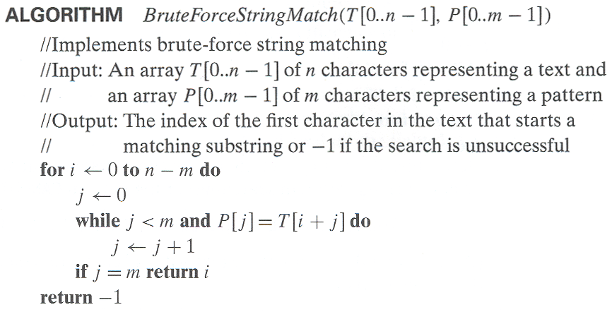

Slide 52
Recursive procedure
11.Compute the factorial of a positive integer ‘n’ using recursive procedure
12.Compute nCr using recursive procedure. Assume that ‘n’ and ‘r’ are non-negative integers.

Slide 53
12.Compute nCr using recursive procedure. Assume that ‘n’ and ‘r’ are non-negative integers.
NCRP PROC NEAR
CMP AL,AH
JZ RE1
CMP AH,0
JZ RE1
CMP AH,01H
JZ REN
DEC AL
PUSH AX
CALL NCRP
POP AX
DEC AH
PUSH AX
CALL NCRP
POP AX
RET
RE1: INC CX
RET
REN: MOV BL,AL
ADD CX,BX
RET
NCRP ENDS
END START
CODE ENDS
CODE SEGMENT
:
MOV AL, n
MOV AH, r
MOV CX,0
MOV BX,0
CALL NCRP
MOV NCR,CX
MOV AH,4CH
INT 21H

Slide 54
13.Generate the first ‘n’ Fibonacci numbers.
Ex: n=5 ,Fib series:0,1,1,2,3,5,8
Algorithm:
f1=0;Display f1;
f2=1;Display f2;
for i=0 to n-1
{
f3=f2+f1;
display f3;
f1=f2;
f2=f3;
i++;
}

Slide 55
14.Program to simulate a Decimal Up-counter to display 00-99
CLRSCR
UP1: MOV AL,00H
UP: SETCURSOR
CALL DISPLAY
CALL DELAY
ADD AL,01H
DAA
CMP AL,99H
JB UP
SETCURSOR
CALL DISPLAY
CALL DELAY
MOV AH,01H
INT 16H
JZ UP1
MOV AH,4CH
INT 21H
DELAY PROC
PUSH AX
PUSH BX
PUSH CX
MOV CX,07FFFh
L1: MOV BX,0FFFh
L2: DEC BX
JNZ L2
LOOP L1
POP CX
POP BX
POP AX
RET
DELAY ENDP

Slide 56
15.Read a pair of input co-ordinates in BCD and move the cursor to the specified location on the screen.
CALL READBCD
MOV BCD_X,AL
CALL READBCD
MOV BCD_Y,AL
MOV BL, BCD_X
CALL BCD_TO_BIN
MOV BIN_X,BL
MOV BL, BCD_Y
CALL BCD_TO_BIN
MOV BIN_Y,BL
CLRSCR
SETCURSOR BIN_X,BIN_Y
MOV AH,08H
INT 21H

Slide 57
Assignment...
Find GCD of 2 numbers using recursion…

Slide 58
Thank You…

Slide 59
Hardware programs

Slide 60
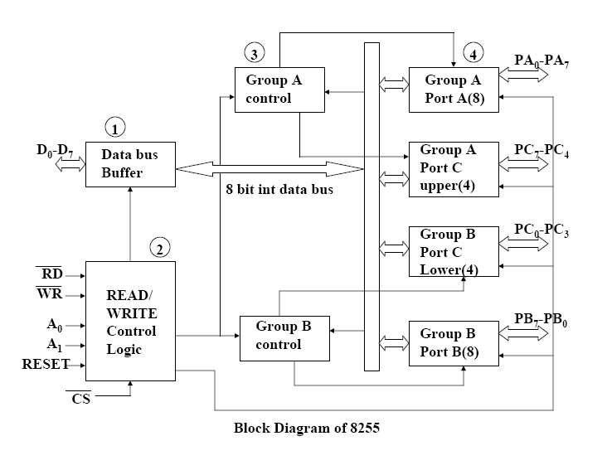
8255A (Programmable Peripheral Interface) Internal Block Diagram and System Connections

Slide 61
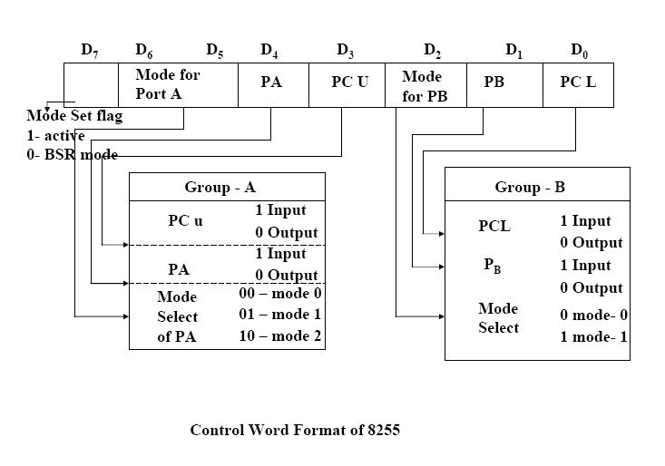

Slide 62
Logic controller interface
1. Read the status of eight input bits from the Logic Controller Interface and display ‘FF’ if it is even parity bits otherwise display 00. Also display number of 1’s in the input data.

Slide 63
PA equ 9800h
PB equ PA+1
PC equ PB+1
PCW equ PC+1
CW equ 82h
CODE SEGMENT
ASSUME CS:CODE
START:
MOV AL,CW ;INITIALIZE 8255
MOV DX,PCW
OUT DX,AL
MOV DX,PB ;READ THE STATUS OF PORT B AFTER SETTING LEDS
IN AL,DX ; AL HAVING PORTB CONTENTS
MOV CL,0
MOV CH,8 ;COUNTER TO ROATATE 8 TIMES
MOV BL,AL
UP1: ROL AL,1
JNC DOWN
INC CL ;INCREMENT COUNTER IF LED IS SET
DOWN: DEC CH
JNZ UP1
MOV CH,CL ;CH=COUNT
SHR CL,1 ; IF THE LAST BIT IN CL REGISTER IS 0, IT IS EVEN ELSE ODD
JC OPARITY
MOV AL,0FFH
JMP D1
OPARITY:
MOV AL,00H
D1: MOV DX,PA
OUT DX,AL
MOV AH,01H
INT 21H
MOV AL,CH
MOV DX,PA
OUT DX,AL
MOV AH,4CH
INT 21H
CODE ENDS
END START

Slide 64
2. Perform the following functions using the Logic Controller Interface.
i. BCD up-down Counter
ii. Ring Counter.

Slide 65
i.BCD up-down Counter
PA EQU 9800h
PB EQU PA+1
PC EQU PB+1
PCW EQU PC+1
CW EQU 80H ; Control Word 80h
N EQU 15H
CODE SEGMENT
ASSUME CS:CODE
START: MOV AL,CW
MOV DX,PCW
OUT DX,AL
UP3: MOV AL,00
UP1: MOV DX,PA
OUT DX,AL
CALL DELAY
ADD AL,1
DAA
CMP AL,N
JBE UP1
UP2: MOV DX,PA
OUT DX,AL
CALL DELAY
SUB AL,1
DAS
CMP AL,0
JA UP2
MOV AH,01H
INT 16H
JZ UP3
EXIT: MOV AH,4CH
INT 21H

Slide 66
DELAY PROC
PUSH CX
PUSH BX
MOV CX,05FFFH
THERE: MOV BX,0FFFFH
HERE: DEC BX
JNZ HERE
DEC CX
JNZ THERE
POP BX
POP CX
RET
DELAY ENDP
CODE ENDS
END START

Slide 67
ii. Ring Counter
PA EQU 9800h
PB EQU PA+1
PC EQU PB+1
PCW EQU PC+1
CW EQU 80H ; Control Word 80h
CODE SEGMENT
ASSUME CS:CODE
START: MOV AL,CW
MOV DX,PCW
OUT DX,AL
MOV AL,01H
UP1: MOV DX,PA
OUT DX,AL
CALL DELAY
ROR AL,1
PUSH AX
MOV AH,01H
INT 16H
POP AX
JZ UP1
MOV AH,4CH
INT 21H

Slide 68
DELAY PROC
PUSH CX
PUSH BX
MOV CX,03FFFH
THERE: MOV BX,03FFFH
HERE: DEC BX
JNZ HERE
DEC CX
JNZ THERE
POP BX
POP CX
RET
DELAY ENDP
CODE ENDS
END START

Slide 69
3. Read the status of two 8-bit inputs (X & Y) from the Logic Controller Interface and display X*Y.

Slide 70
PA EQU 9800H
PB EQU PA+1
PC EQU PB+1
PCW EQU PC+1
CW EQU 82H
DATA SEGMENT
X DB ?
Y DB ?
PROD DB ?
DATA ENDS
CODE SEGMENT
ASSUME CS:CODE,DS:DATA
START: MOV AX, DATA
MOV DS, AX
MOV AL,CW
MOV DX,PCW
OUT DX, AL
MOV DX, PB
IN AL,DX
MOV X,AL
MOV AH,01H
INT 21H
MOV DX,PB
IN AL,DX
MOV Y,AL
MOV AL,X
MUL Y
MOV DX,PA
OUT DX, AL
MOV AH, 4CH
INT 21H
CODE ENDS
END START

Slide 71
Assignment
Johnson counter

